Slide 1
Machine-Level Programming II: Arithmetic & Control Books: Programming from the ground up (Chapter 1-3) Computer Systems (Chapter 3)

Slide 2
Today
Complete addressing mode, address computation (leal)
Arithmetic operations
Control: Condition codes
Conditional branches
While loops

Slide 3
Complete Memory Addressing Modes
Most General Form
D(Rb,Ri,S) Mem[Reg[Rb]+S*Reg[Ri]+ D]
D: Constant “displacement” 1, 2, or 4 bytes
Rb: Base register: Any of 8 integer registers
Ri: Index register: Any, except for %esp
Unlikely you’d use %ebp, either
S: Scale: 1, 2, 4, or 8 (why these numbers?)
Special Cases
(Rb,Ri) Mem[Reg[Rb]+Reg[Ri]]
D(Rb,Ri) Mem[Reg[Rb]+Reg[Ri]+D]
(Rb,Ri,S) Mem[Reg[Rb]+S*Reg[Ri]]

Slide 4
Address Computation Instruction
leal Src,Dest
Src is address mode expression
Set Dest to address denoted by expression
Uses
Computing addresses without a memory reference
E.g., translation of p = &x[i];
Computing arithmetic expressions of the form x + k*y
k = 1, 2, 4, or 8
Example
int mul12(int x)
{
return x*12;
}
Converted to ASM by compiler:
leal (%eax,%eax,2), %eax ;t <- x+x*2
sall $2, %eax ;return t<<2

Slide 5
Today
Complete addressing mode, address computation (leal)
Arithmetic operations
Control: Condition codes
Conditional branches
While loops

Slide 6
Some Arithmetic Operations
Two Operand Instructions:
Format Computation
addl Src,Dest Dest = Dest + Src
subl Src,Dest Dest = Dest − Src
imull Src,Dest Dest = Dest * Src
sall Src,Dest Dest = Dest << Src Also called shll
sarl Src,Dest Dest = Dest >> Src Arithmetic
shrl Src,Dest Dest = Dest >> Src Logical
xorl Src,Dest Dest = Dest ^ Src
andl Src,Dest Dest = Dest & Src
orl Src,Dest Dest = Dest | Src
Watch out for argument order!

Slide 7
Some Arithmetic Operations
One Operand Instructions
incl Dest Dest = Dest + 1
decl Dest Dest = Dest − 1
negl Dest Dest = − Dest
notl Dest Dest = ~Dest
See book for more instructions

Slide 8
Arithmetic Expression Example
arith:
pushl %ebp
movl %esp, %ebp
movl 8(%ebp), %ecx
movl 12(%ebp), %edx
leal (%edx,%edx,2), %eax
sall $4, %eax
leal 4(%ecx,%eax), %eax
addl %ecx, %edx
addl 16(%ebp), %edx
imull %edx, %eax
popl %ebp
ret
Set
Up
int arith(int x, int y, int z)
{
int t1 = x+y;
int t2 = z+t1;
int t3 = x+4;
int t4 = y * 48;
int t5 = t3 + t4;
int rval = t2 * t5;
return rval;
}
Body
Finish

Slide 9
Understanding arith
 | •
 | •
 | •
16 | z
12 | y
8 | x
4 | Rtn Addr
0 | Old %ebp
int arith(int x, int y, int z)
{
int t1 = x+y;
int t2 = z+t1;
int t3 = x+4;
int t4 = y * 48;
int t5 = t3 + t4;
int rval = t2 * t5;
return rval;
}
Offset
%ebp
movl 8(%ebp), %ecx
movl 12(%ebp), %edx
leal (%edx,%edx,2), %eax
sall $4, %eax
leal 4(%ecx,%eax), %eax
addl %ecx, %edx
addl 16(%ebp), %edx
imull %edx, %eax

Slide 10
Understanding arith
Stack
 | •
 | •
 | •
16 | z
12 | y
8 | x
4 | Rtn Addr
0 | Old %ebp
int arith(int x, int y, int z)
{
int t1 = x+y;
int t2 = z+t1;
int t3 = x+4;
int t4 = y * 48;
int t5 = t3 + t4;
int rval = t2 * t5;
return rval;
}
Offset
%ebp
movl 8(%ebp), %ecx # ecx = x
movl 12(%ebp), %edx # edx = y
leal (%edx,%edx,2), %eax # eax = y*3
sall $4, %eax # eax *= 16 (t4)
leal 4(%ecx,%eax), %eax # eax = t4 +x+4 (t5)
addl %ecx, %edx # edx = x+y (t1)
addl 16(%ebp), %edx # edx += z (t2)
imull %edx, %eax # eax = t2 * t5 (rval)

Slide 11
Observations about arith
Instructions in different order from C code
Some expressions require multiple instructions
Some instructions cover multiple expressions
Get exact same code when compile:
(x+y+z)*(x+4+48*y)
int arith(int x, int y, int z)
{
int t1 = x+y;
int t2 = z+t1;
int t3 = x+4;
int t4 = y * 48;
int t5 = t3 + t4;
int rval = t2 * t5;
return rval;
}
movl 8(%ebp), %ecx # ecx = x
movl 12(%ebp), %edx # edx = y
leal (%edx,%edx,2), %eax # eax = y*3
sall $4, %eax # eax *= 16 (t4)
leal 4(%ecx,%eax), %eax # eax = t4 +x+4 (t5)
addl %ecx, %edx # edx = x+y (t1)
addl 16(%ebp), %edx # edx += z (t2)
imull %edx, %eax # eax = t2 * t5 (rval)

Slide 12
Another Example
logical:
pushl %ebp
movl %esp,%ebp
movl 12(%ebp),%eax
xorl 8(%ebp),%eax
sarl $17,%eax
andl $8185,%eax
popl %ebp
ret
Set
Up
int logical(int x, int y)
{
int t1 = x^y;
int t2 = t1 >> 17;
int mask = (1<<13) - 7;
int rval = t2 & mask;
return rval;
}
Body
Finish
movl 12(%ebp),%eax # eax = y
xorl 8(%ebp),%eax # eax = x^y (t1)
sarl $17,%eax # eax = t1>>17 (t2)
andl $8185,%eax # eax = t2 & mask (rval)

Slide 13
Another Example
logical:
pushl %ebp
movl %esp,%ebp
movl 12(%ebp),%eax
xorl 8(%ebp),%eax
sarl $17,%eax
andl $8185,%eax
popl %ebp
ret
Set
Up
int logical(int x, int y)
{
int t1 = x^y;
int t2 = t1 >> 17;
int mask = (1<<13) - 7;
int rval = t2 & mask;
return rval;
}
Body
Finish
movl 12(%ebp),%eax # eax = y
xorl 8(%ebp),%eax # eax = x^y (t1)
sarl $17,%eax # eax = t1>>17 (t2)
andl $8185,%eax # eax = t2 & mask (rval)

Slide 14
Another Example
logical:
pushl %ebp
movl %esp,%ebp
movl 12(%ebp),%eax
xorl 8(%ebp),%eax
sarl $17,%eax
andl $8185,%eax
popl %ebp
ret
Set
Up
int logical(int x, int y)
{
int t1 = x^y;
int t2 = t1 >> 17;
int mask = (1<<13) - 7;
int rval = t2 & mask;
return rval;
}
Body
Finish
movl 12(%ebp),%eax # eax = y
xorl 8(%ebp),%eax # eax = x^y (t1)
sarl $17,%eax # eax = t1>>17 (t2)
andl $8185,%eax # eax = t2 & mask (rval)

Slide 15
Another Example
logical:
pushl %ebp
movl %esp,%ebp
movl 12(%ebp),%eax
xorl 8(%ebp),%eax
sarl $17,%eax
andl $8185,%eax
popl %ebp
ret
Set
Up
int logical(int x, int y)
{
int t1 = x^y;
int t2 = t1 >> 17;
int mask = (1<<13) - 7;
int rval = t2 & mask;
return rval;
}
Body
Finish
2¹³ = 8192, 2¹³ – 7 = 8185
movl 12(%ebp),%eax # eax = y
xorl 8(%ebp),%eax # eax = x^y (t1)
sarl $17,%eax # eax = t1>>17 (t2)
andl $8185,%eax # eax = t2 & mask (rval)

Slide 16
Today
Complete addressing mode, address computation (leal)
Arithmetic operations
Control: Condition codes
Conditional branches
Loops

Slide 17
Processor State (IA32, Partial)
Information about currently executing program
Temporary data ( %eax, … )
Location of runtime stack ( %ebp,%esp )
Location of current code control point ( %eip, … )
Status of recent tests ( CF, ZF, SF, OF )
%eax
%ecx
%edx
General purpose
registers
%ebx
%esi
%edi
%esp
Current stack top
%ebp
Current stack frame
%eip
Instruction pointer
CF
ZF
SF
OF
Condition codes

Slide 18
Condition Codes (Implicit Setting)
Single bit registers
CF Carry Flag (for unsigned) SF Sign Flag (for signed)
ZF Zero Flag OF Overflow Flag (for signed)
Implicitly set (think of it as side effect) by arithmetic operations
Example: addl/addq Src,Dest ↔ t = a+b
CF set if carry out from most significant bit (unsigned overflow)
ZF set if t == 0
SF set if t < 0 (as signed)
OF set if two’s-complement (signed) overflow (a>0 && b>0 && t<0) || (a<0 && b<0 && t>=0)
Not set by lea instruction

Slide 19
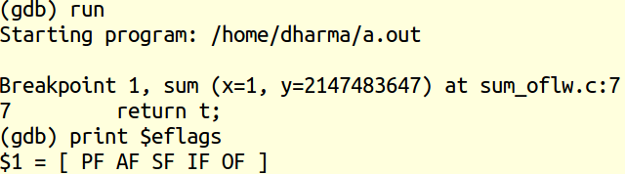
Which flags are set? (see GDB view)
#include <limits.h>
int sum(int x, int y) {
int t = x + y;
return t;
}
int main() {
return sum(1, INT_MAX);
}
SF – because t is negative
OF – because overflow in add
Notes:
Ignore other flags for this lecture.

Slide 20
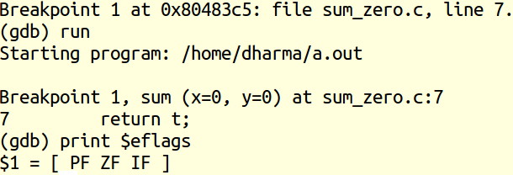
Zero flag
#include <limits.h>
int sum(int x, int y) {
int t = x + y;
return t;
}
int main() {
return sum(0, 0);
}
ZF – because t is zero

Slide 21
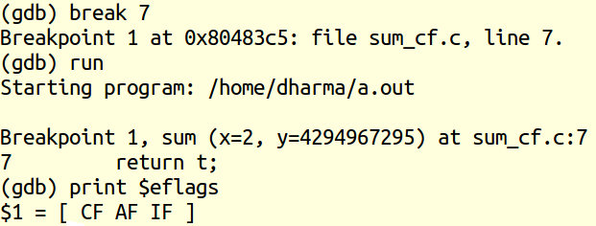
Carry flag
#include <limits.h>
unsigned int sum(unsigned int x, unsigned int y) {
int t = x + y;
return t;
}
int main() {
return sum(2, UINT_MAX);
}
CF – because x+y overflows

Slide 22
Condition Codes (Explicit Setting: Compare)
Explicit Setting by Compare Instruction
cmpl/cmpq Src2, Src1
cmpl b,a like computing a-b without setting destination
CF set if carry out from most significant bit (used for unsigned comparisons)
ZF set if a == b
SF set if (a-b) < 0 (as signed)
OF set if two’s-complement (signed) overflow (a>0 && b<0 && (a-b)<0) || (a<0 && b>0 && (a-b)>0)

Slide 23
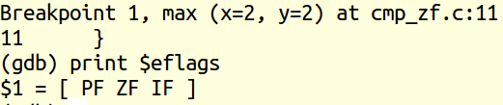
Zero flag (comparison)
int max(int x, int y) {
if(x <= y) {
return y;
} else {
return x;
}
}
int main(){
return max(2, 2);
}
ZF – because x == y

Slide 24
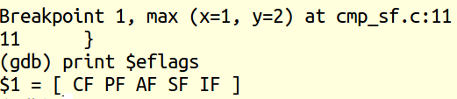
Sign flag (comparison)
int max(int x, int y) {
if(x <= y) {
return y;
} else {
return x;
}
}
int main(){
return max(1, 2);
}
SF – because 1-2 <= 0 (see disass in the next slide)
CF – because 1-2 <= 0

Slide 25
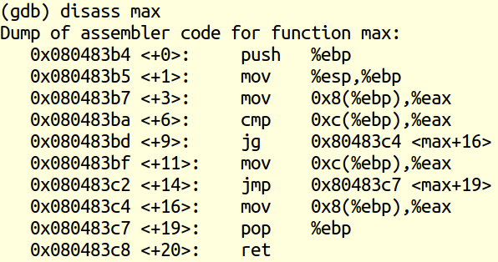
Disassembly of max
eax = 1
0xc(%ebp) = 2
cmp 2, 1
or 1-2 <= 0

Slide 26
Condition Codes (Explicit Setting: Test)
Explicit Setting by Test instruction
testl/testq Src2, Src1 testl b,a like computing a&b without setting destination
Sets condition codes based on value of Src1 & Src2
ZF set when a&b == 0
SF set when a&b < 0

Slide 27
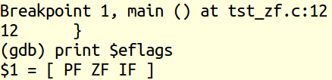
Zero flag (Condition code)
int main(){
int x = 1, y = 2;
if(x & y) return 1;
else return 0;
}
ZF – because 1&2 == 0 (see disass in the next slide)

Slide 28
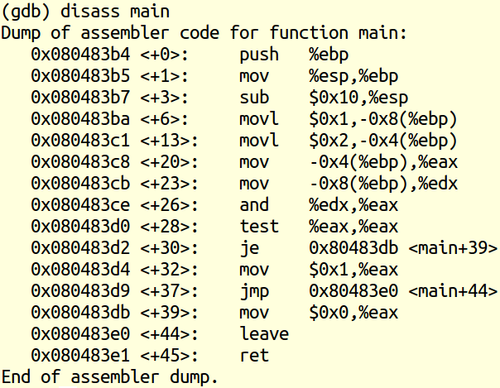
Disass for zero flag demo
test will not modify eax

Slide 29
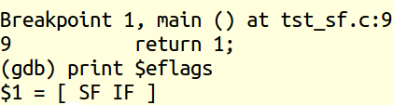
Sign flag (Condition code a & b < 0)
int main(){
int x = -1, y = -2;
if(x & y) return 1;
else return 0;
}
SF – because -1&-2 == -2 < 0

Slide 30
Reading Condition Codes
SetX Instructions
Set single byte based on combinations of condition codes
SetX | Condition | Description
sete | ZF | Equal / Zero
setne | ~ZF | Not Equal / Not Zero
sets | SF | Negative
setns | ~SF | Nonnegative
setg | ~(SF^OF)&~ZF | Greater (Signed)
setge | ~(SF^OF) | Greater or Equal (Signed)
setl | (SF^OF) | Less (Signed)
setle | (SF^OF)|ZF | Less or Equal (Signed)
seta | ~CF&~ZF | Above (unsigned)
setb | CF | Below (unsigned)

Slide 31
Reading Condition Codes (Cont.)
SetX Instructions:
Set single byte based on combination of condition codes
One of 8 addressable byte registers
Does not alter remaining 3 bytes
Typically use movzbl to finish job
%eax | %ah | %al
%ecx | %ch | %cl
%edx | %dh | %dl
%ebx | %bh | %bl
%esi
%edi
%esp
%ebp
int gt (int x, int y)
{
return x > y;
}
Body
movl 12(%ebp),%eax # eax = y
cmpl %eax,8(%ebp) # Compare x : y
setg %al # al = x > y
movzbl %al,%eax # Zero rest of %eax

Slide 32
Reading Condition Codes: x86-64
SetX Instructions:
Set single byte based on combination of condition codes
Does not alter remaining 3 bytes
int gt (long x, long y)
{
return x > y;
}
long lgt (long x, long y)
{
return x > y;
}
Bodies
cmpl %esi, %edi
setg %al
movzbl %al, %eax
cmpq %rsi, %rdi
setg %al
movzbl %al, %eax
Is %rax zero?
Yes: 32-bit instructions set high order 32 bits to 0!

Slide 33
Today
Complete addressing mode, address computation (leal)
Arithmetic operations
x86-64
Control: Condition codes
Conditional branches & Moves
Loops

Slide 34
Jumping
jX Instructions
Jump to different part of code depending on condition codes
jX | Condition | Description
jmp | 1 | Unconditional
je | ZF | Equal / Zero
jne | ~ZF | Not Equal / Not Zero
js | SF | Negative
jns | ~SF | Nonnegative
jg | ~(SF^OF)&~ZF | Greater (Signed)
jge | ~(SF^OF) | Greater or Equal (Signed)
jl | (SF^OF) | Less (Signed)
jle | (SF^OF)|ZF | Less or Equal (Signed)
ja | ~CF&~ZF | Above (unsigned)
jb | CF | Below (unsigned)

Slide 35
Conditional Branch Example
int absdiff(int x, int y)
{
int result;
if (x > y) {
result = x-y;
} else {
result = y-x;
}
return result;
}
absdiff:
pushl %ebp
movl %esp, %ebp
movl 8(%ebp), %edx
movl 12(%ebp), %eax
cmpl %eax, %edx
jle .L6
subl %eax, %edx
movl %edx, %eax
jmp .L7
.L6:
subl %edx, %eax
.L7:
popl %ebp
ret
Setup
Body1
Body2a
Body2b
Finish

Slide 36
Conditional Branch Example (Cont.)
int goto_ad(int x, int y)
{
int result;
if (x <= y) goto Else;
result = x-y;
goto Exit;
Else:
result = y-x;
Exit:
return result;
}
absdiff:
pushl %ebp
movl %esp, %ebp
movl 8(%ebp), %edx
movl 12(%ebp), %eax
cmpl %eax, %edx
jle .L6
subl %eax, %edx
movl %edx, %eax
jmp .L7
.L6:
subl %edx, %eax
.L7:
popl %ebp
ret
Setup
Body1
Body2a
C allows “goto” as means of transferring control
Closer to machine-level programming style
Generally considered bad coding style
Body2b
Finish

Slide 37
Conditional Branch Example (Cont.)
int goto_ad(int x, int y)
{
int result;
if (x <= y) goto Else;
result = x-y;
goto Exit;
Else:
result = y-x;
Exit:
return result;
}
absdiff:
pushl %ebp
movl %esp, %ebp
movl 8(%ebp), %edx
movl 12(%ebp), %eax
cmpl %eax, %edx
jle .L6
subl %eax, %edx
movl %edx, %eax
jmp .L7
.L6:
subl %edx, %eax
.L7:
popl %ebp
ret
Setup
Body1
Body2a
Body2b
Finish

Slide 38
Conditional Branch Example (Cont.)
int goto_ad(int x, int y)
{
int result;
if (x <= y) goto Else;
result = x-y;
goto Exit;
Else:
result = y-x;
Exit:
return result;
}
absdiff:
pushl %ebp
movl %esp, %ebp
movl 8(%ebp), %edx
movl 12(%ebp), %eax
cmpl %eax, %edx
jle .L6
subl %eax, %edx
movl %edx, %eax
jmp .L7
.L6:
subl %edx, %eax
.L7:
popl %ebp
ret
Setup
Body1
Body2a
Body2b
Finish

Slide 39
Conditional Branch Example (Cont.)
int goto_ad(int x, int y)
{
int result;
if (x <= y) goto Else;
result = x-y;
goto Exit;
Else:
result = y-x;
Exit:
return result;
}
absdiff:
pushl %ebp
movl %esp, %ebp
movl 8(%ebp), %edx
movl 12(%ebp), %eax
cmpl %eax, %edx
jle .L6
subl %eax, %edx
movl %edx, %eax
jmp .L7
.L6:
subl %edx, %eax
.L7:
popl %ebp
ret
Setup
Body1
Body2a
Body2b
Finish

Slide 40
General Conditional Expression Translation
C Code
val = Test ? Then_Expr : Else_Expr;
val = x>y ? x-y : y-x;
Test is expression returning integer
= 0 interpreted as false
≠ 0 interpreted as true
Create separate code regions for then & else expressions
Execute appropriate one
Goto Version
nt = !Test;
if (nt) goto Else;
val = Then_Expr;
goto Done;
Else:
val = Else_Expr;
Done:
. . .

Slide 41
Using Conditional Moves
Conditional Move Instructions
Instruction supports:
if (Test) Dest ← Src
Supported in post-1995 x86 processors
GCC does not always use them
Wants to preserve compatibility with ancient processors
Enabled for x86-64
Use switch –march=686 for IA32
Why?
Branches are very disruptive to instruction flow through pipelines
Conditional move do not require control transfer
C Code
val = Test
? Then_Expr
: Else_Expr;
Goto Version
tval = Then_Expr;
result = Else_Expr;
t = Test;
if (t) result = tval;
return result;

Slide 42
Conditional Move Example: x86-64
int absdiff(int x, int y) {
int result;
if (x > y) {
result = x-y;
} else {
result = y-x;
}
return result;
}
absdiff:
movl %edi, %edx
subl %esi, %edx # tval = x-y
movl %esi, %eax
subl %edi, %eax # result = y-x
cmpl %esi, %edi # Compare x:y
cmovg %edx, %eax # If >, result = tval
ret
x in %edi
y in %esi

Slide 43
Bad Cases for Conditional Move
Expensive Computations
val = Test(x) ? Hard1(x) : Hard2(x);
Both values get computed
Only makes sense when computations are very simple
Risky Computations
val = p ? *p : 0;
Both values get computed
May have undesirable effects
Computations with side effects
val = x > 0 ? x*=7 : x+=3;
Both values get computed
Must be side-effect free

Slide 44
Today
Complete addressing mode, address computation (leal)
Arithmetic operations
x86-64
Control: Condition codes
Conditional branches and moves
Loops

Slide 45
“Do-While” Loop Example
C Code
Goto Version
int pcount_do(unsigned x) {
int result = 0;
do {
result += x & 0x1;
x >>= 1;
} while (x);
return result;
}
int pcount_do(unsigned x)
{
int result = 0;
loop:
result += x & 0x1;
x >>= 1;
if (x)
goto loop;
return result;
}
Count number of 1’s in argument x (“popcount”)
Use conditional branch to either continue looping or to exit loop

Slide 46
“Do-While” Loop Compilation
Goto Version
int pcount_do(unsigned x) {
int result = 0;
loop:
result += x & 0x1;
x >>= 1;
if (x)
goto loop;
return result;
}
movl $0, %ecx # result = 0
.L2: # loop:
movl %edx, %eax
andl $1, %eax # t = x & 1
addl %eax, %ecx # result += t
shrl %edx # x >>= 1
jne .L2 # If !0, goto loop
Registers:
%edx x
%ecx result

Slide 47
General “Do-While” Translation
C Code
Goto Version
do
Body
while (Test);
loop:
Body
if (Test)
goto loop
Body:
Test returns integer
= 0 interpreted as false
≠ 0 interpreted as true
{
Statement₁;
Statement₂;
…
Statement_{n};
}

Slide 48
“While” Loop Example
C Code
Goto Version
int pcount_while(unsigned x) {
int result = 0;
while (x) {
result += x & 0x1;
x >>= 1;
}
return result;
}
int pcount_do(unsigned x) {
int result = 0;
if (!x) goto done;
loop:
result += x & 0x1;
x >>= 1;
if (x)
goto loop;
done:
return result;
}

Slide 49
General “While” Translation
While version
while (Test)
Body
Goto Version
Do-While Version
if (!Test)
goto done;
loop:
Body
if (Test)
goto loop;
done:
if (!Test)
goto done;
do
Body
while(Test);
done:

Slide 50
“For” Loop Example
C Code
#define WSIZE 8*sizeof(int)
int pcount_for(unsigned x) {
int i;
int result = 0;
for (i = 0; i < WSIZE; i++) {
unsigned mask = 1 << i;
result += (x & mask) != 0;
}
return result;
}
Is this code equivalent to other versions?

Slide 51
“For” Loop Form
Init
General Form
i = 0
for (Init; Test; Update )
Body
Test
i < WSIZE
Update
i++
for (i = 0; i < WSIZE; i++) {
unsigned mask = 1 << i;
result += (x & mask) != 0;
}
Body
{
unsigned mask = 1 << i;
result += (x & mask) != 0;
}

Slide 52
“For” Loop → While Loop
For Version
for (Init; Test; Update )
Body
While Version
Init;
while (Test ) {
Body
Update;
}

Slide 53
“For” Loop → … → Goto
Init;
if (!Test)
goto done;
loop:
Body
Update
if (Test)
goto loop;
done:
For Version
for (Init; Test; Update )
Body
While Version
Init;
while (Test ) {
Body
Update;
}
Init;
if (!Test)
goto done;
do
Body
Update
while(Test);
done:

Slide 54
“For” Loop Conversion Example
Goto Version
C Code
int pcount_for_gt(unsigned x) {
int i;
int result = 0;
i = 0;
if (!(i < WSIZE))
goto done;
loop:
{
unsigned mask = 1 << i;
result += (x & mask) != 0;
}
i++;
if (i < WSIZE)
goto loop;
done:
return result;
}
#define WSIZE 8*sizeof(int)
int pcount_for(unsigned x) {
int i;
int result = 0;
for (i = 0; i < WSIZE; i++) {
unsigned mask = 1 << i;
result += (x & mask) != 0;
}
return result;
}
Init
!Test
Body
Update
Test
Initial test can be optimized away

Slide 55
Summarizing
C Control
if-then-else
do-while
while, for
Assembler Control
Conditional jump
Conditional move
Indirect jump
Compiler generates code sequence to implement more complex control

